Slide 1

Zomato Order & Restaurant Analysis Using Power BI
Transforming raw data into actionable business insights for the food and beverage industry
Kousalya Shanmugam Sundari

Slide 2






Skills Gained From This Project
SQL Mastery
Data Cleaning
Data import and transformation techniques
Preprocessing and quality assurance
Data Modelling
DAX Functions
Power BI relationships and structures
Advanced calculations and measures
Visualizations
Business Insights
Interactive and compelling dashboards
KPI analysis and strategic recommendations

Slide 3
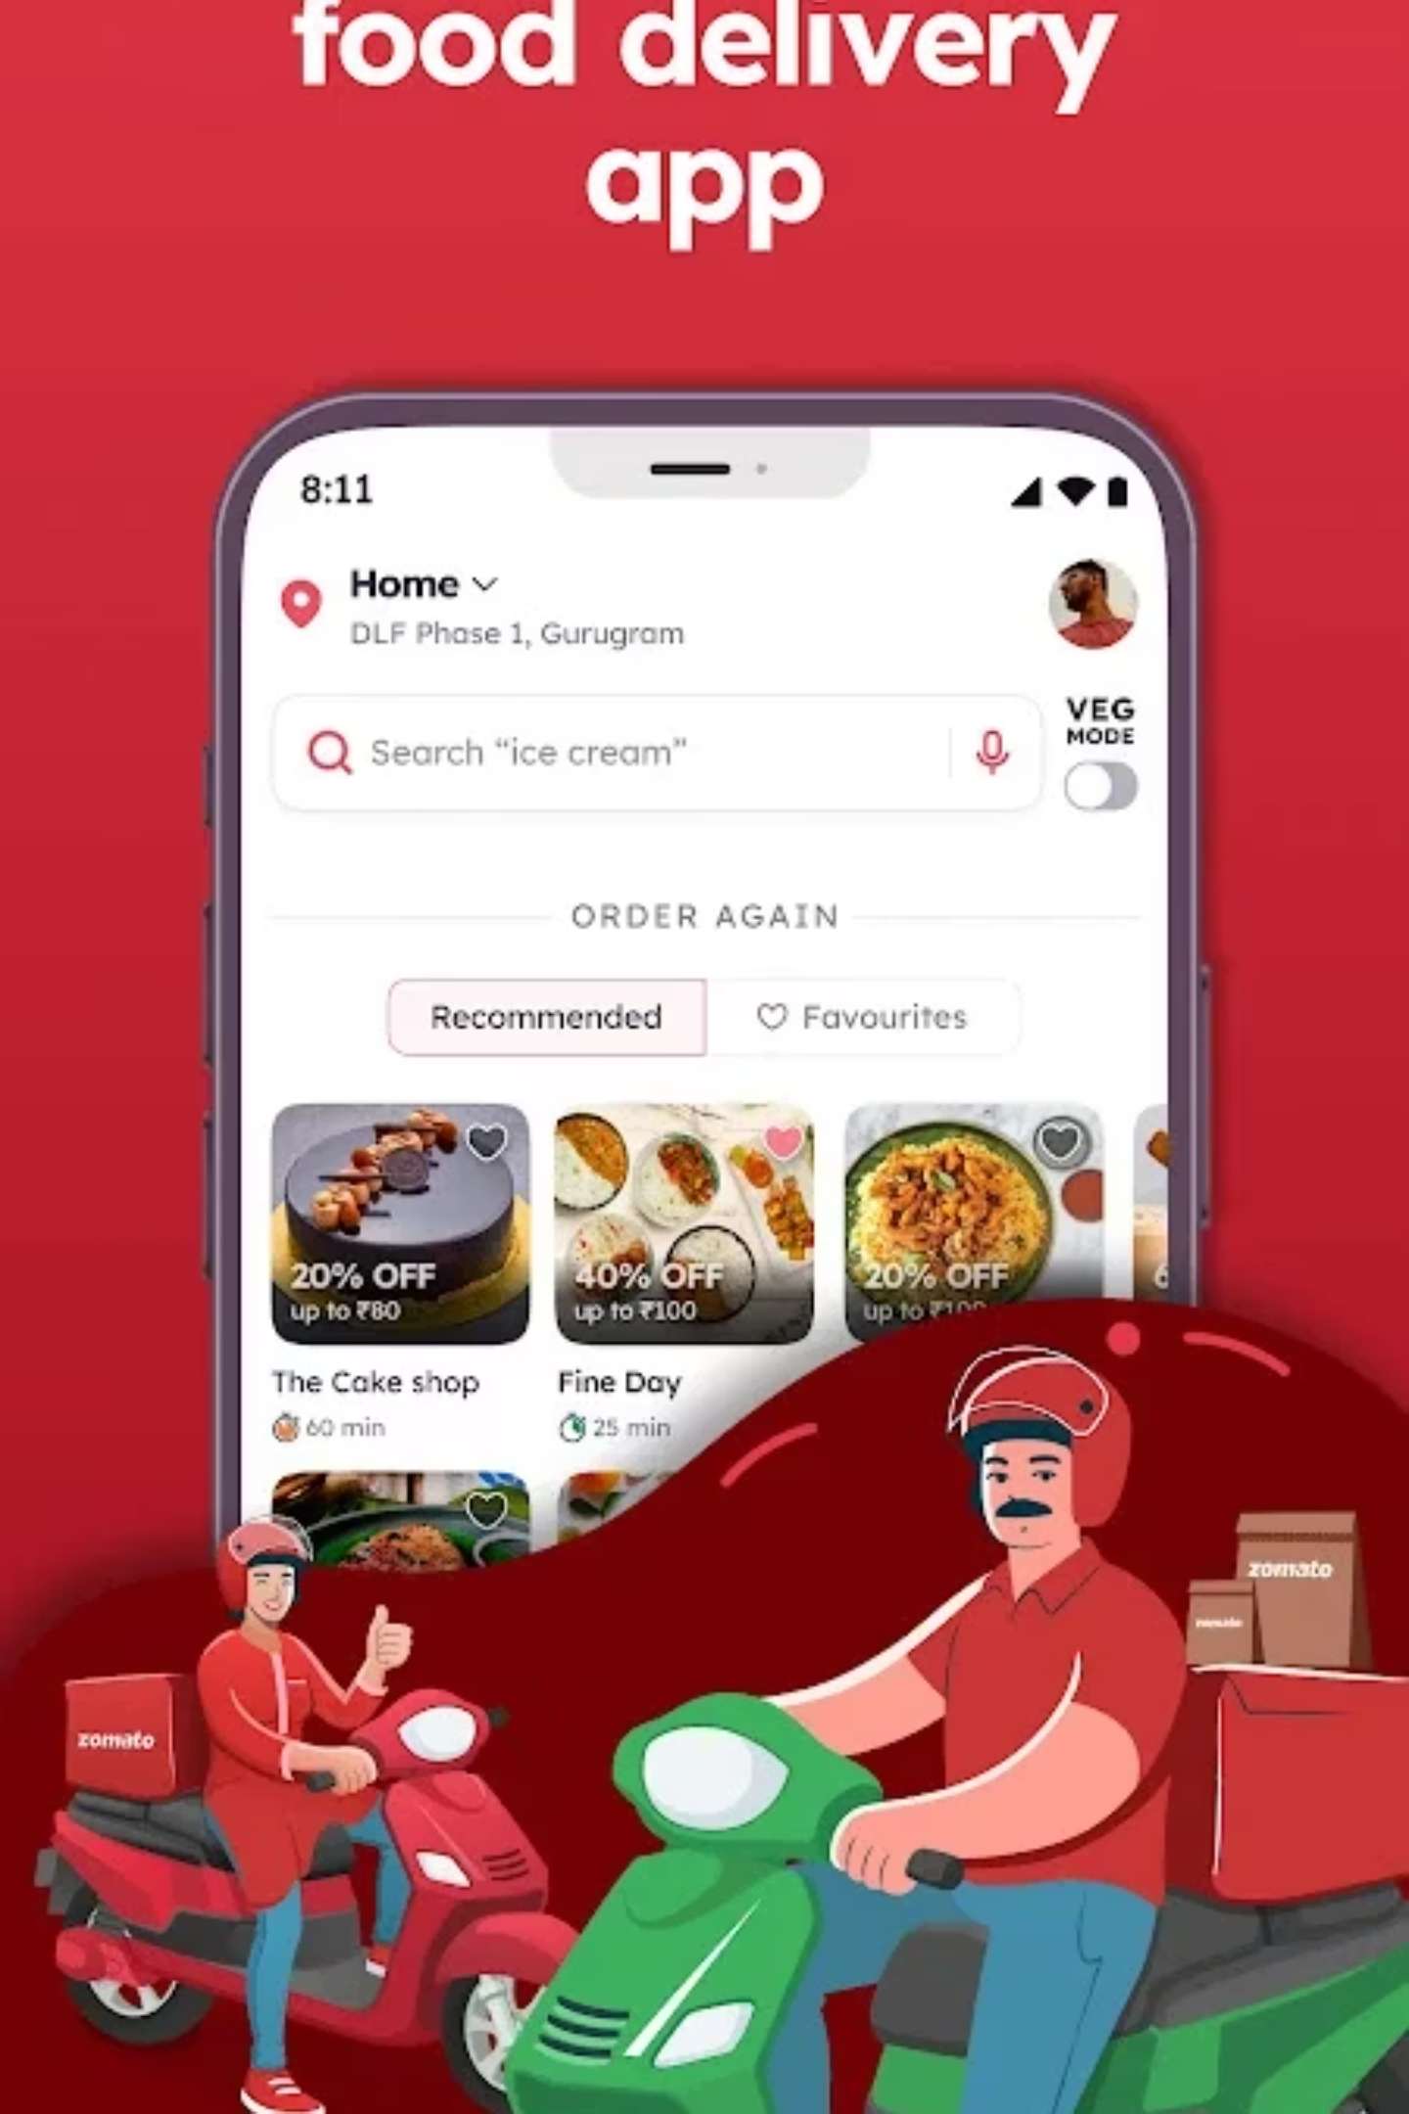

The Challenge
Analyze and visualize Zomato's restaurant and order data to uncover critical patterns in customer behaviour and business performance. The goal is to convert raw data into actionable business insights for strategic decision-making.
5
Analysis Dimensions
Domain: Food & Beverage, Business Analytics
Key Focus Areas
Customer preferences and ordering patterns
Restaurant performance metrics
Pricing influence on order volume
Location-based ordering behaviour
Delivery efficiency optimization

Slide 4





Business Use Cases
Top Performers
Price Analysis
Location Intelligence
Identify high-performing restaurants and understand the factors driving their success for replication across the network.
Analyze the relationship between pricing strategies and order volumes to optimize revenue generation.
Understand city- and area-wise customer demand patterns to guide expansion and resource allocation.
Delivery Optimization
Revenue Forecasting
Evaluate delivery performance metrics to enhance customer satisfaction and operational efficiency.
Evaluate revenue trends over time to support accurate forecasting and strategic planning initiatives.

Slide 5




Project Approach
A systematic three-stage process to transform raw data into business intelligence
SQL Data Import
Cleaning and transformation of raw datasets
Power BI Modelling
Data relationships and DAX calculations
Dashboard Creation
Interactive visualizations and insights

Slide 6

Stage 1: SQL Data Foundation
Database Setup
Created ZomatoDB with two core tables to house the complete dataset:
Zomato_Restaurants — Restaurant details, ratings, and location data
Zomato_Orders — Order transactions, amounts, and delivery information
Imported CSV files into MySQL with correct data types and
established relationships to ensure data integrity and
optimal query performance.

Slide 7
SQL Transformations
1
2
Data Cleaning
Data Exploration
Removed duplicate records
Count restaurants per city
Filled missing values with meaningful defaults
Top 5 cities by order volume
Standardized data formats
Total revenue per restaurant
3
4
Data Aggregation
Data Join Operations
Average order value per city
Combined restaurant and order details
Top 5 restaurants by total sales
Created comprehensive analytical views
Revenue trends over time
Established data relationships

Slide 8
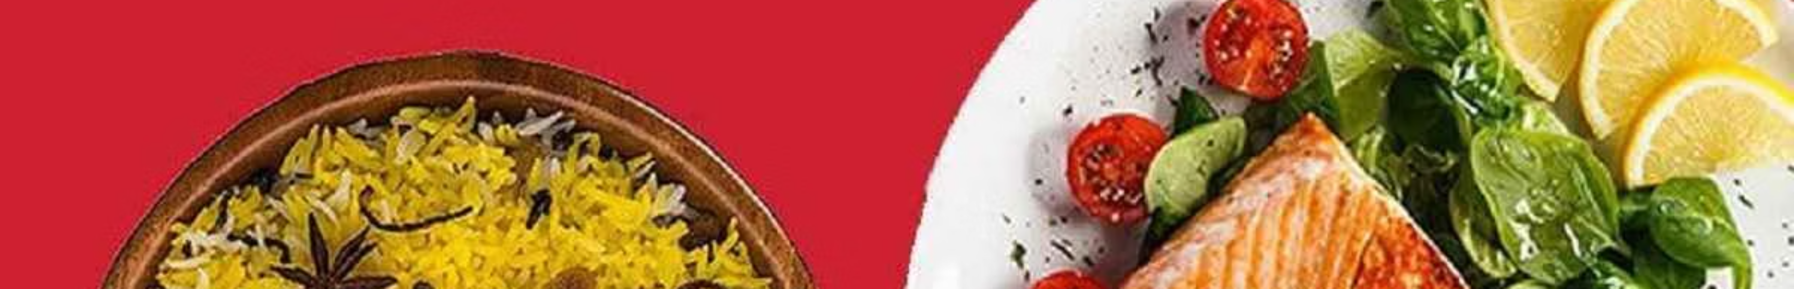
Stage 2: Power BI Data Preparation
01
02
Data Import
Data Validation
Loaded cleaned SQL output into Power BI
Verified data types and removed unnecessary fields
03
04
Relationship Building
Hierarchy Creation
Established relationships on restaurant_id
Built date hierarchies for trend analysis

Slide 9

Restaurant Distribution Analysis
Number of Restaurants per City
Bar chart visualization reveals significant concentration of restaurants in major metropolitan areas.
Key Insights
Mumbai and Bangalore have the highest restaurant density, indicating mature markets
Smaller cities show low restaurant availability
Clear opportunity for market expansion in underserved regions
Supply-demand imbalance in emerging markets

Slide 10




Order Distribution & Demand Patterns
35%
28%
Mumbai
Bangalore
Highest order volume
Strong tech hub demand
22%
15%
Delhi
Other Cities
Capital city orders
Emerging markets
Demand is heavily concentrated in Mumbai, Bangalore, and Delhi. Interestingly, some cities generate high orders despite fewer restaurants, revealing a demand exceeds supply opportunity for strategic expansion.

Slide 11

Revenue Trends Over Time
Line chart analysis reveals consistent upward trajectory in order amounts, with notable patterns emerging around specific time periods.
Consistent Growth
Peak Periods
Upward trend in order amounts demonstrates healthy business expansion
Significant peaks observed around weekends and festive seasons
Strategic Planning
Insights enable better staffing, delivery, and marketing resource allocation

Slide 12

Correlation Analysis Findings
Scatter plot visualizations reveal critical relationships between key performance metrics
Strong Positive Correlation
Minimal Impact
Higher total ratings → higher average rating
Delivery time has negligible effect on overall ratings
Restaurants with more reviews tend to maintain quality standards
Customers prioritize food quality over speed
Price range and rating show weak correlation — customers focus more on taste and service quality than pricing when rating restaurants

Slide 13





Top Revenue Generators
Top Performer
Highest revenue with consistent ratings
Second Place
Strong order volume in prime location
Third Place
High customer satisfaction scores
Fourth Place
Consistent performance metrics
Fifth Place
Growing market presence
High earners share common traits: higher number of orders, consistent ratings, and strategic locations in high-demand areas. The revenue difference between Top-1 and Top-5 is notable, indicating significant performance variation.

Slide 14

Geographic Revenue Distribution
Revenue by Area
Critical Insights
Tree map visualization highlights revenue concentration across
different geographic zones.
60%
Top 2 Areas
Revenue concentration
Area-A and Area-B dominate revenue contribution
Areas with fewer restaurants still generate high revenue
Strong customer base in underserved locations
Opportunity for targeted restaurant onboarding

Slide 15
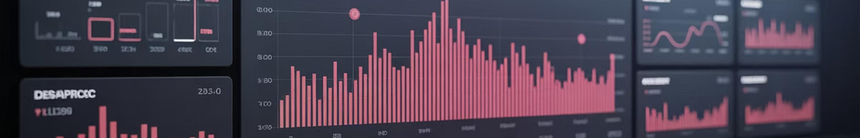
Key Performance Indicators
₹15.57M
₹1.04K
+9%
Total Revenue
Average Order Value
Revenue Growth
Cumulative business performance
Healthy transaction size
Positive business trajectory
The dashboard reveals positive business growth with healthy average order values across all locations. The 9% revenue increase demonstrates strong market performance and customer engagement.
Business growth is positive with healthy average order value across locations, indicating strong market fundamentals and customer satisfaction

Slide 16
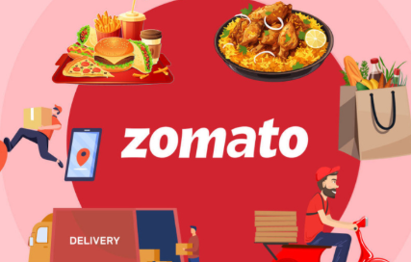
Food you!
Just like a great meal, data becomes meaningful when shared.
Thanks for taking the time to dive into Zomato’s insights with me!
- Kousalya Shanmugam Sundari

